Slide 1
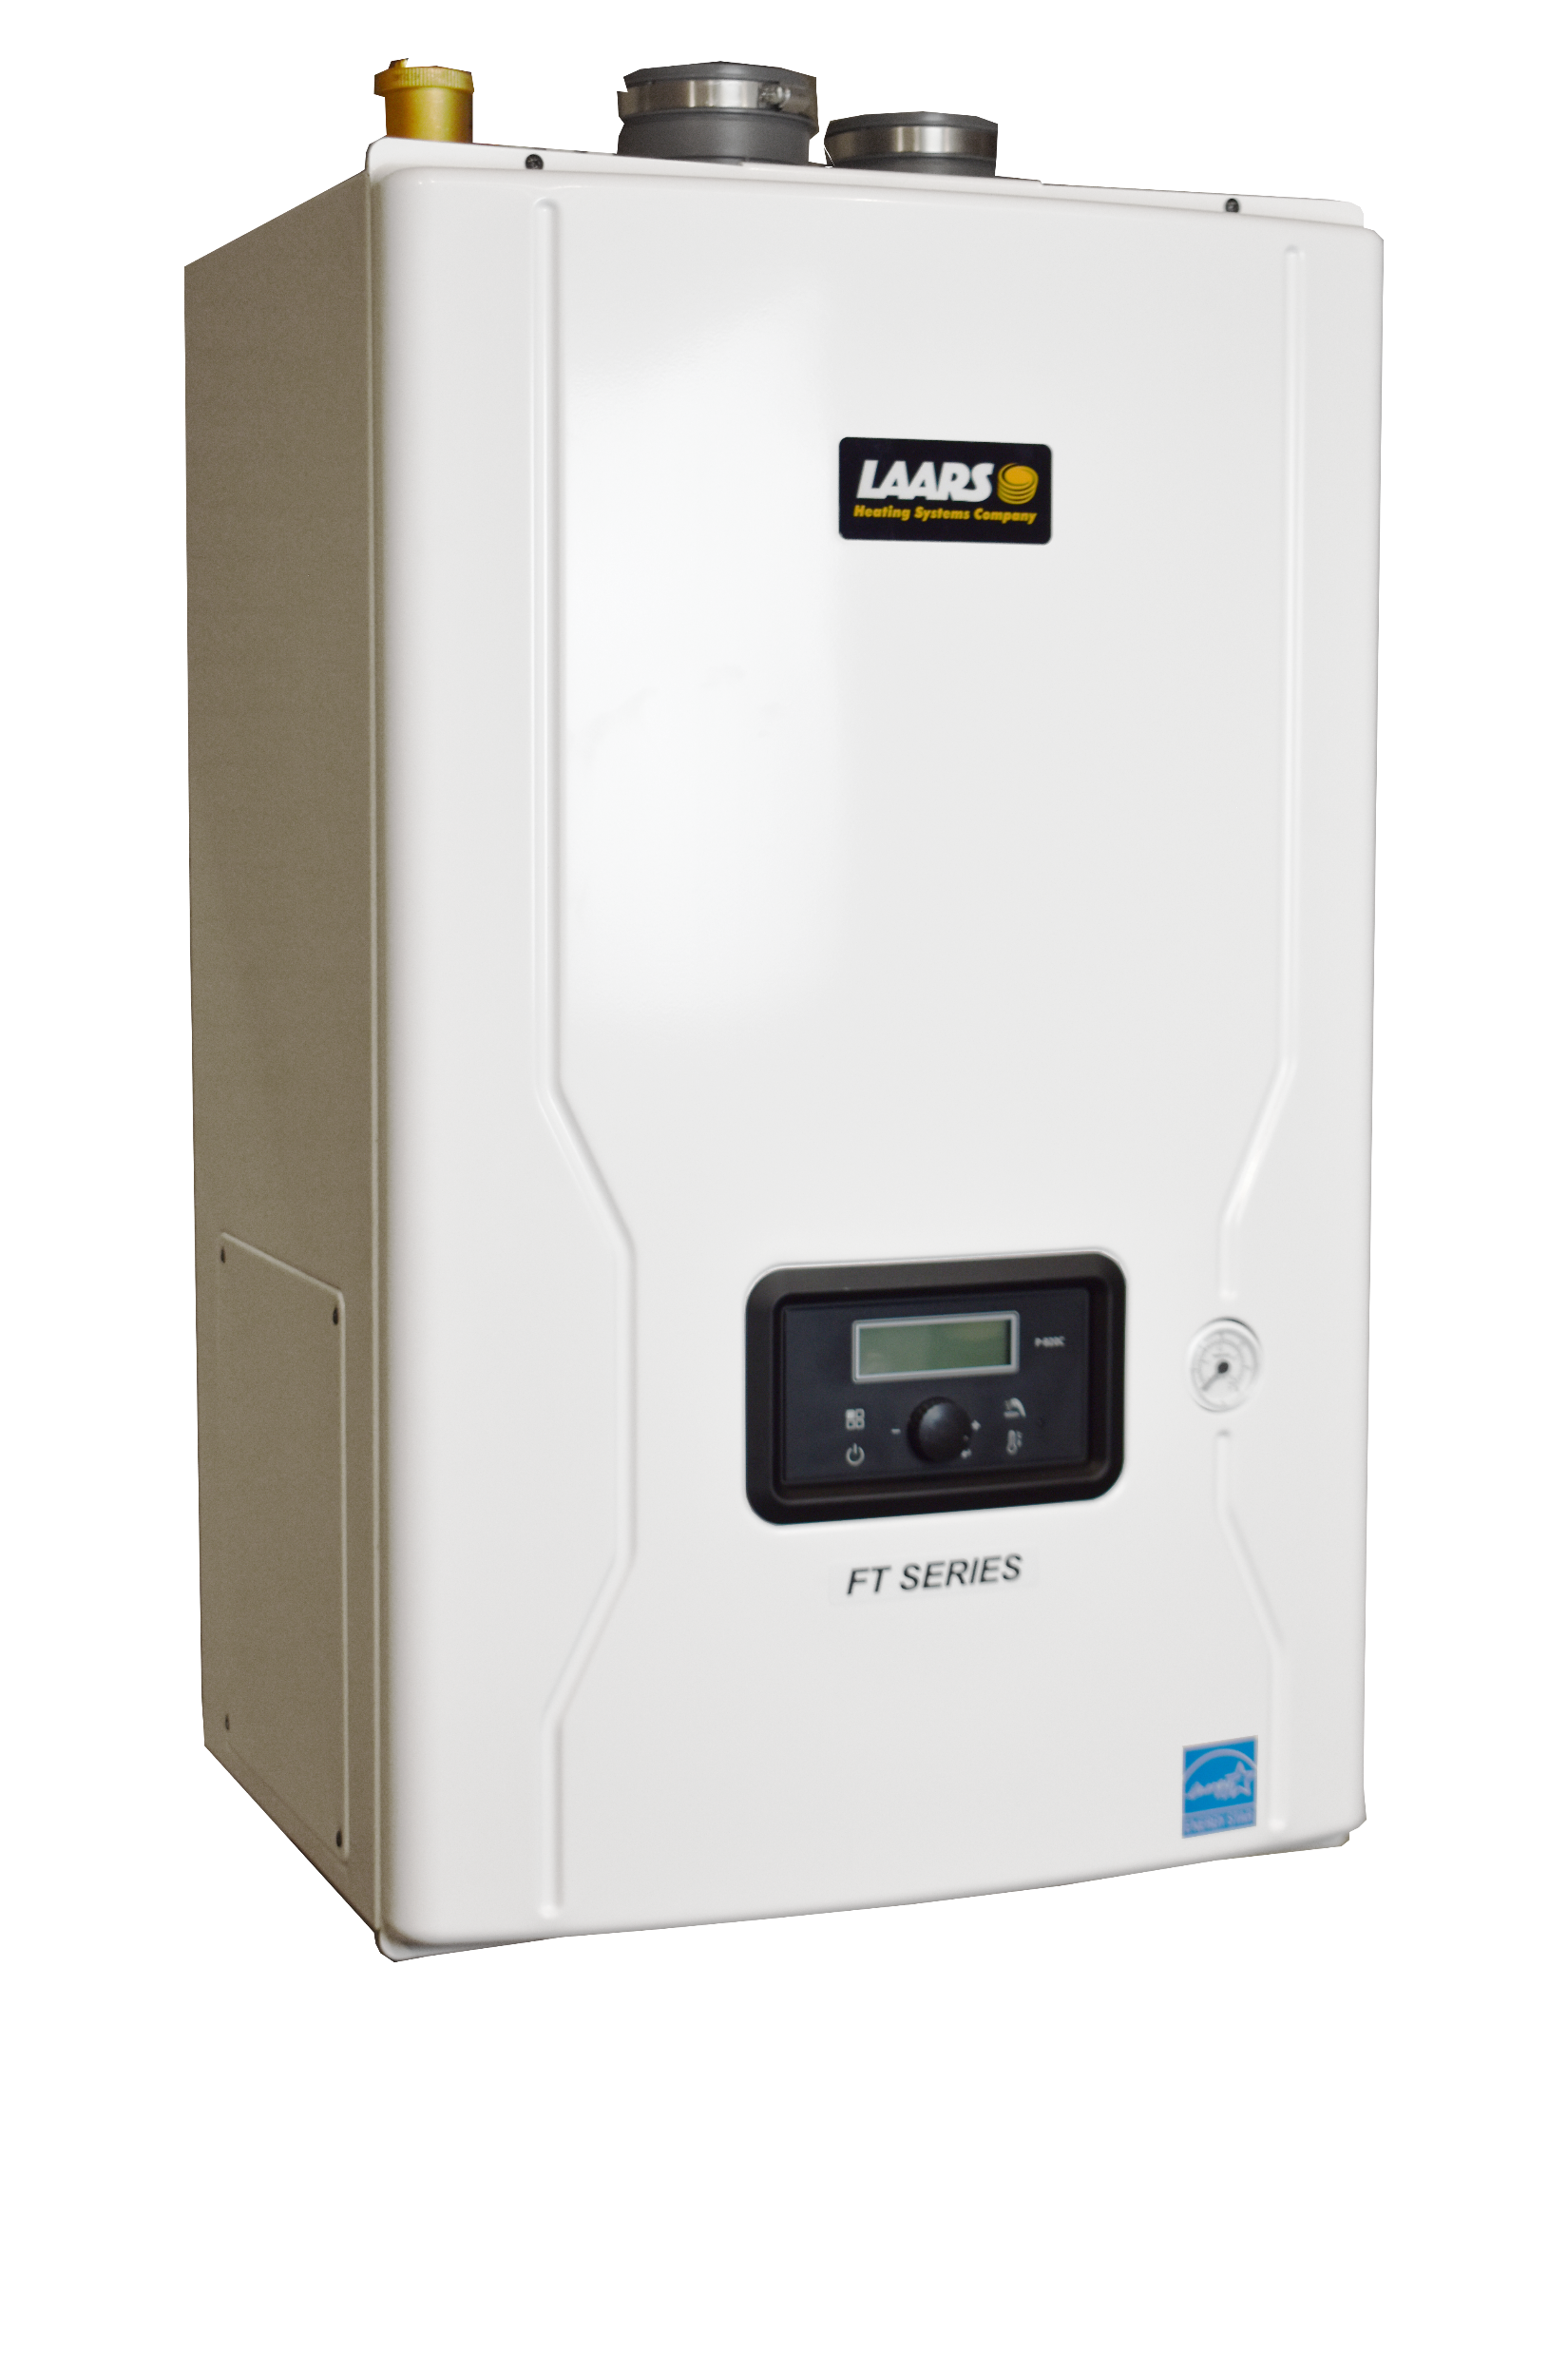
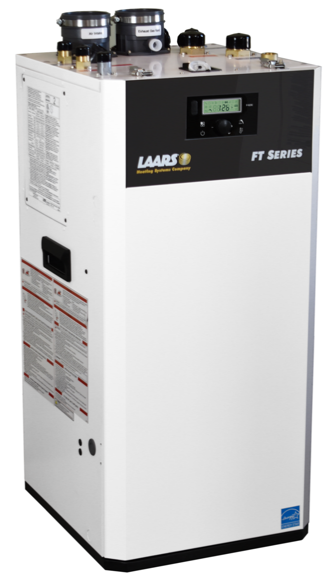
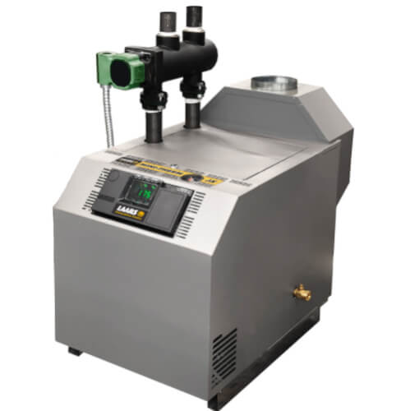
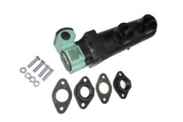
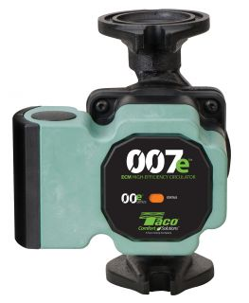
QUICK REFERENCE GUIDE
INSERT LOGO HERE
Type | Model | Min Input BTU | Max Output BTU | Turn Down | Connections |  |  |  |  | AFUE
Type | Model | Min BTU | Max BTU |  | Boiler Supply/Return | DHW | DHW GPM @ 70° rise | Gas | Vent
Heating Wall Boiler | MFTHW100 | 20,000 | 93,000 | 5:1 | 1 1/4” | N/A | N/A | 3/4” | 2” or 3” | 95%
Heating Wall Boiler | MFTHW140 | 14,000 | 129,000 | 10:1 | 1 1/4”
Heating Wall Boiler | MFTHW199 | 19,000 | 181,000 |  | 1 1/4” |  |  |  |  | N/A
Combi Wall Boiler | MFTCW140 | 14,000 | 129,000 |  | 1” | 3/4” | 3.5
Combi Wall Boiler | MFTCW199 | 19,000 | 181,000 |  | 1” | 3/4” | 5.2
Heating Floor Boiler | LFTHF199 | 19,000 | 181,000 |  | 1 1/2” | N/A | N/A
Combi Floor Boiler | LFTCF199 | 19,000 | 181,000 |  | 1 1/2” | 3/4” | 5.2
Included With LAARS FT® Series Boilers
FT FLOOR | FT WALL HUNG
Low Loss Header | Boiler Pump
Boiler Pump | LP Conversion Kit
LP Conversion Kit | Fuse, O-ring & gasket Spare Kit
Fuse, O-ring & Gasket Kit | Outdoor Sensor
3-in-1 Brass Adapter | Air Vent
Air Vent | Pressure Relief Valve
Pressure Relief Valve | Wall Mount Kit
Anti-scald Mixing Valve (combi)
Outdoor Sensor
FT SERIES® WALL BOILERS
FT SERIES® FLOOR BOILERS
Type | Model | Min Input BTU | Max Output BTU | Low Loss Header w/ pump | Connections |  |  | AFUE
Type | Model | Min BTU | Max BTU |  | Supply/Return | Gas | Vent
Heating Boiler | JX50 | 50,000 | 42,000 | Optional Accessory | 1 1/4” | 3/4” | 4” | 84%
Heating Boiler | JX75 | 75,000 | 63,000 | Optional Accessory |  |  | 5”
Heating Boiler | JX100 | 100,000 | 84,000 | Optional Accessory |  |  | 5” | N/A
Heating Boiler | JX125 | 125,000 | 105,000 | Standard |  |  | 6”
Heating Boiler | JX150 | 150,000 | 126,000 | Standard |  |  | 6”
Heating Boiler | JX200 | 200,000 | 168,000 | Standard |  |  | 7”
Included With LAARS Mini-Therm® JX Boilers
Low Loss Header
(Factory Installed JX125-JX200)
PN: CA019600
Pressure Relief Valve
Internal Taco 007E Boiler Pump
(Factory Installed with LLH)
MINI-THERM® JX BOILERS
Browse LAARS Residential Products
Customer Service & Product Support 800-900-9276
Doc 9292-Cus

Slide 2
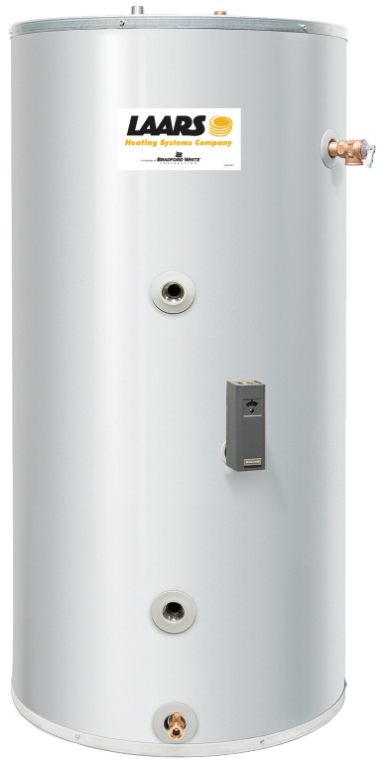
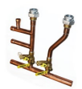
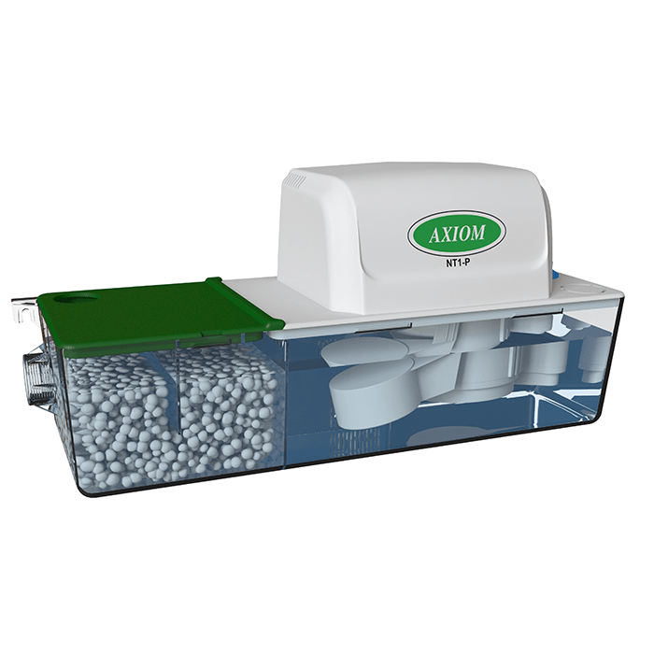
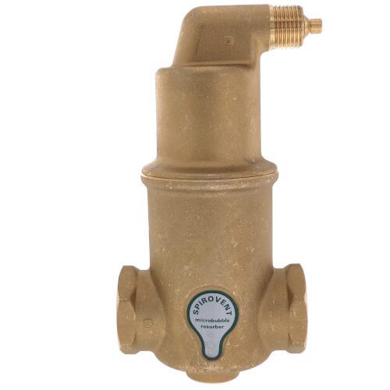
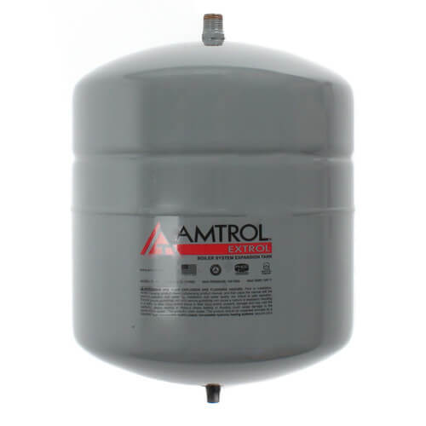
QUICK REFERENCE GUIDE
INSERT LOGO HERE
Model # |  | Height In. | Dia. In. | Hot & Cold Water Connections | Boiler Supply / Return Connections | Min. Recommended Boiler Supply / Return | Min. Recommended Pump Size with FT Series® Boiler
LS-SW-2-30-L | ENTER | 33 5/8 | 22 | ¾” MPT | 1” FPT | 1” | Grundfos 15-58 or equal
LS-SW-2-40R-L | YOUR | 38 1/4 | 22 |  |  |  | Grundfos 15-58 or equal
LS-SW-2-50R-L | PART | 46 1/4 | 22 |  |  |  | Grundfos 15-58 or equal
LS-SW-2-65-L | 154450 | 59 1/4 | 22 |  |  |  | Grundfos 15-58 or equal
LS-SW-2-65-L | NUMBERS | 59 1/4 | 22
LS-SW-2-80-L |  | 59 | 24 |  |  | 1 ¼” | Grundfos 15-58 or equal
LS-SW-2-120-L |  | 62 1/2 | 28 ¼ | 1” FPT |  |  | Grundfos 15-58 or equal
LOGO
LAARS-STOR® INDIRECT WATER HEATERS
LAARS-STOR®
Single Wall Glass Lined Carbon Steel
Lifetime Warranty
Includes T&P valve & aquastat
For help with sizing for specific applications, contact our technical support team
LAARS FT SERIES WALL BOILER MANIFOLD KITS
HYDRAULIC SEPARATORS
Model |  | Used With | System Connection | Indirect Tank Connection
P2135900 | P2135900 | Heat Only 100/140 | 1 ¼” | 1”
P2135800 | P2135800 | Heat Only 199 | 1 ½” | 1 ¼”
P2134400 | P2134400 | Combi 140/199 | 1 ½” | N/A
Size |  | Used With
1” NPT |  | MFTWH100
1” Pro Press |  | MFTWH100
1 ¼” NPT |  | MFTWH140-199
1 ¼” Pro Press |  | MFTWH140-199
LOGO
LOGO
CONDENSATE PUMPS & NEUTRALIZERS
EXPANSION TANKS
AIR ELIMINATORS
Brand |  | BTUH
Little Giant
Axiom |  | 500,000
Axiom |  | 400,000
Axiom |  | 400,000
Axiom |  | 1,000,000
Aspen
Aspen
Size |  | Brand
#15 |  | Amtrol
#30 |  | Amtrol
#60 |  | Amtrol
#15 |  | Zilmet
#30 |  | Zilmet
#60 |  | Zilmet
#15 |  | Zilmet Flat
#30 |  | Zilmet Flat
#60 |  | Zilmet Flat
Size |  | Use With
1” NPT |  | FT SERIES 100
1” Press |  | FT 100
1” Sweat |  | FT 100
1 ¼” NPT |  | FT SERIES 140-199
1 ¼” Press
1 ¼” Sweat
LOGO
LOGO
LOGO
Browse LAARS Residential Products
Customer Service & Product Support 800-900-9276
Doc 9292-Cus

Slide 3
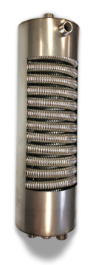
FEATURES & BENEFITS
INSERT LOGO HERE
Stainless steel fire tube heat exchanger design
Up to 10:1 Turndown
Multiple vent options
2” or 3”
Polypropylene, PVC, CPVC, Stainless steel
Built-in Primary/Secondary piping (Floor Model)
All piping connections on top (Floor Model)
Domestic water recirculation tap (Floor Model)
3 pump outputs onboard- System (CH), DHW (Recirc or Indirect Tank), Boiler (Primary)
Built-in Supply/Return boiler sensors – no system sensor required
Best in class access to internal components
FT Series Wall & Floor Boilers
Unique Shell & Tube DHW heat exchanger
1 gallon of stored hot water on standby
¾” DHW stainless steel corrugated coil
Prevents scale build up, less maintenance over lifetime, better flow rates
Piped as hydraulic separator on FT Floor Model – no manifold or primary/secondary required
Industry leading continuous hot water delivery 5.2 GPM at 70º rise
Shell & Tube Heat Exchanger and Low Loss Header
Browse LAARS Residential Products
Customer Service & Product Support 800-900-9276
Doc 9292-Cus

Slide 4
FEATURES & BENEFITS
INSERT LOGO HERE
Hybrid heat exchanger design – Low mass
Cast iron wet walls with copper fin tube horizontal passes
Spark to pilot ignition
Internal low loss header with Taco 007E boiler pump(JX125-JX200)
No primary/secondary piping required
Compact footprint and light weight
Standard tapping makes for easy cast iron retrofit
Mini-Therm® JX Boiler
Glass lined or Stainless steel options available
Size range: 30-120 gallon
Factory installed T&P valve, adjustable aquastat, low point drain
Lifetime warranty
Premium 2” Non-CFC foam insulation
Laars-Stor® Indirect Water Heater
Browse LAARS Residential Products
Customer Service & Product Support 800-900-9276
Doc 9292-Cus

